Slide 1


ROW (REMOTE OPTICAL WATCHER)
OIL SPILL
DETECTION SYSTEM

Slide 2







COMPANY BACKGROUND
Laser Diagnostic Instruments
1991
Tallinn, Estonia
35+ years Remote Sensing and Spectral Fluorescence Analysis
R&D and Manufacturer
ISO 9001:2015
ATEX / IECEx 2026
2 / 14

Slide 3
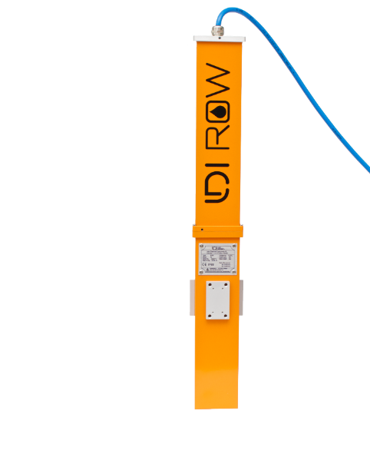





WHAT IS ROW?
Fluorescence detection
Sends Alert
Excitation UV Beam
Emissions
Oil’s Native Fluorescence
3 / 14

Slide 4
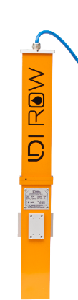
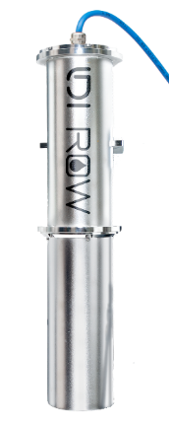
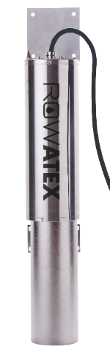
WHAT IS ROW?
Remote Optical Watcher
1
Detects/Monitors: 1s Response
2
Immediate alerts: alarms or GSM
3
Wide Detection: (Light, Medium, Heavy Fractions) detection
3 MAIN MODELS:
Aluminum ROW
Stainless Steel ROW
ATEX EXD ROW
4 / 14

Slide 5
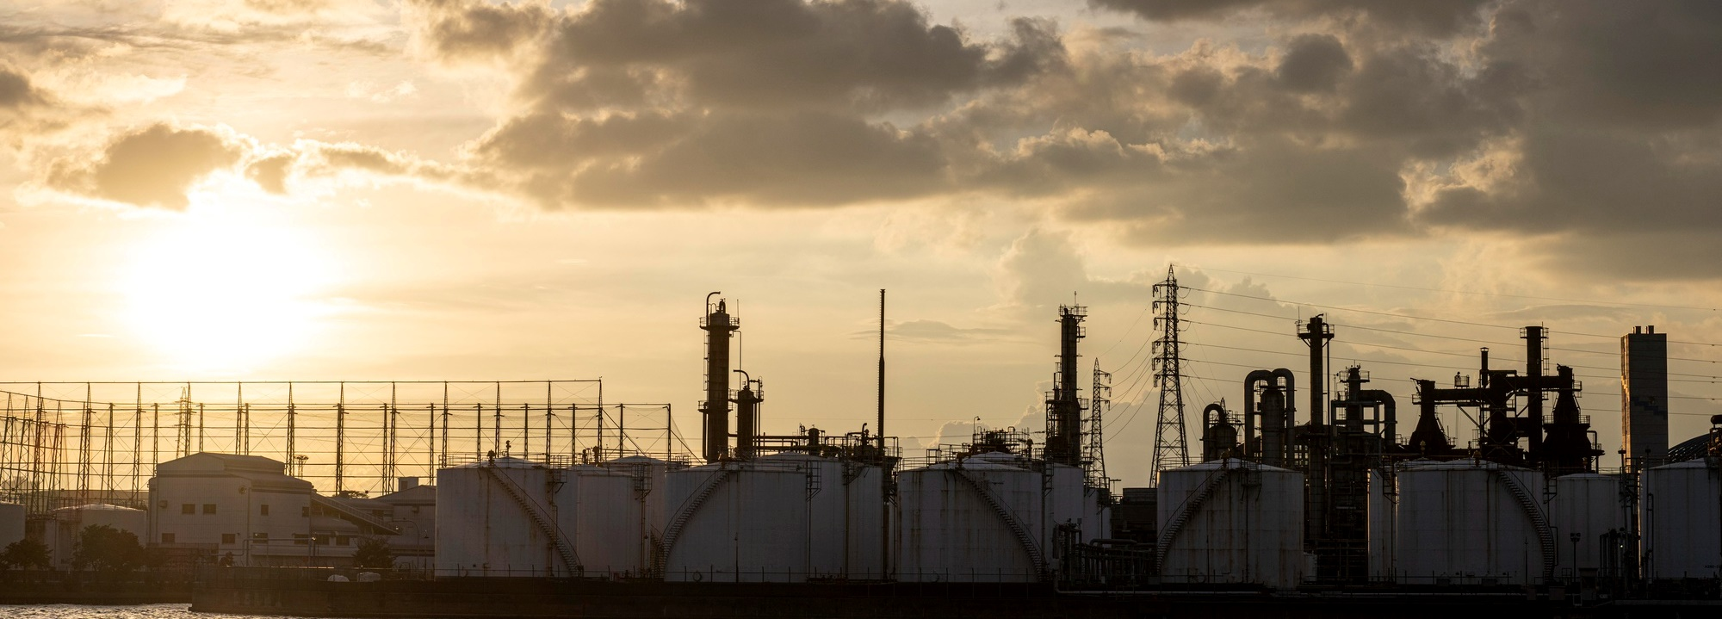




WHY EARLY DETECTION?
Reduce Damages
Reduce Losses
Reduce Costs
Reduce Downtimes
5 / 14

Slide 6
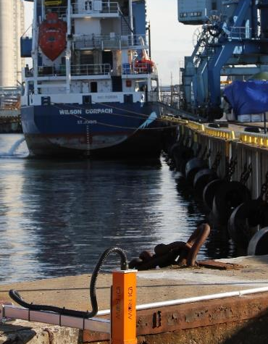
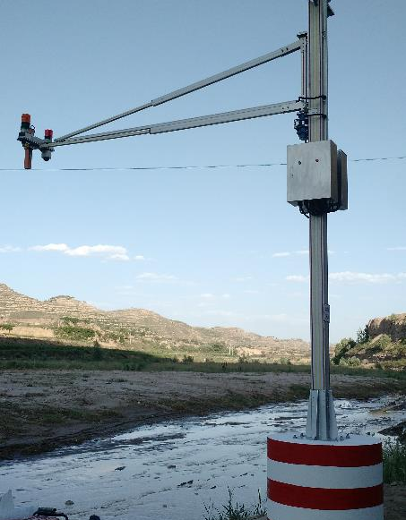
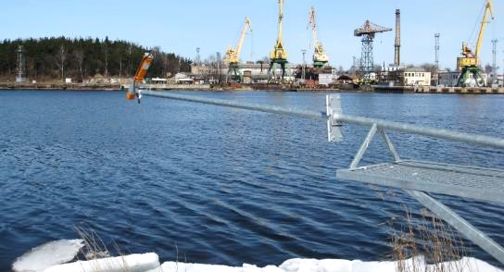
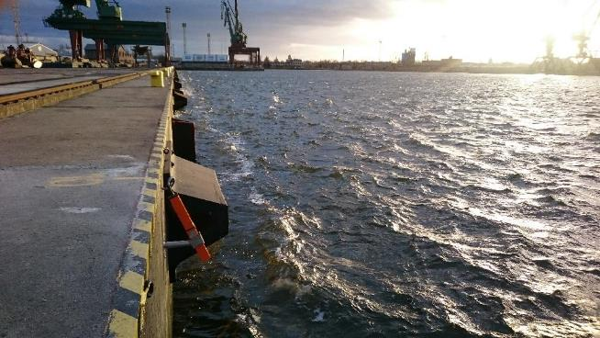
TRADITIONAL APPLICATIONS
Ports and Waterways
Port Monitoring, Latvia
Port, Estonia
River Monitoring, China
Port Monitoring, Poland
6 / 14

Slide 7
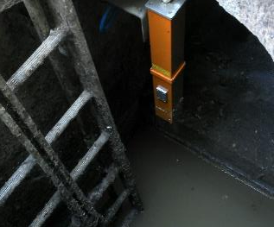
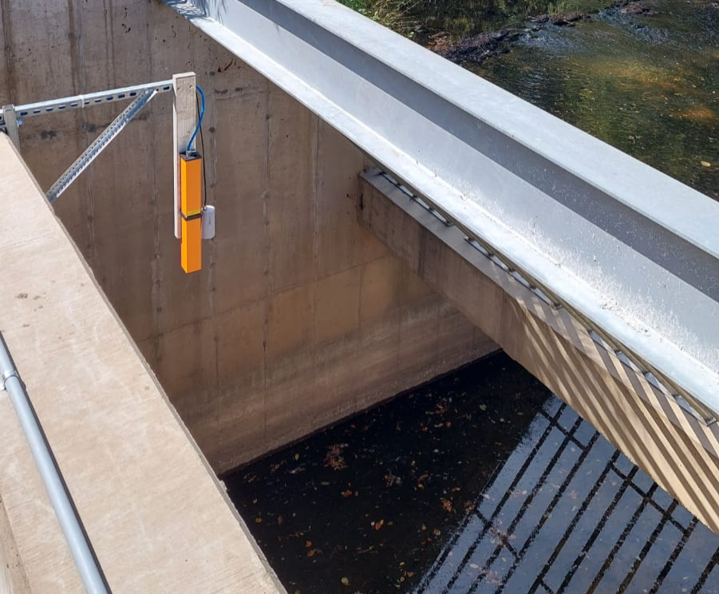
PRESENT APPLICATIONS
Industries, Sewers and Water Systems
Sewer, France
WWTP, USA
7 / 14

Slide 8
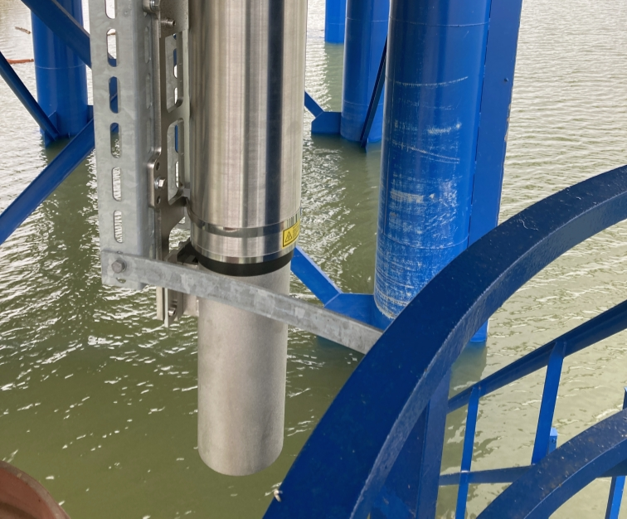
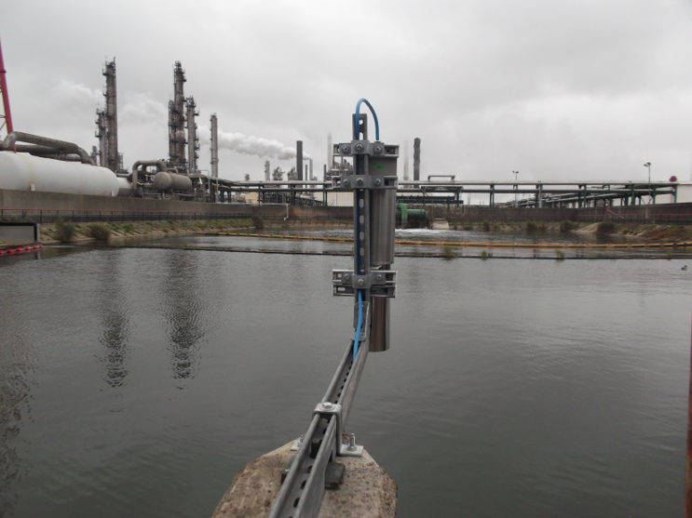
PRESENT APPLICATIONS
Oil and gas facilities: refineries, terminals
Oil terminal, Slovakia
Oil Refinery sump, Belgium
8 / 14

Slide 9
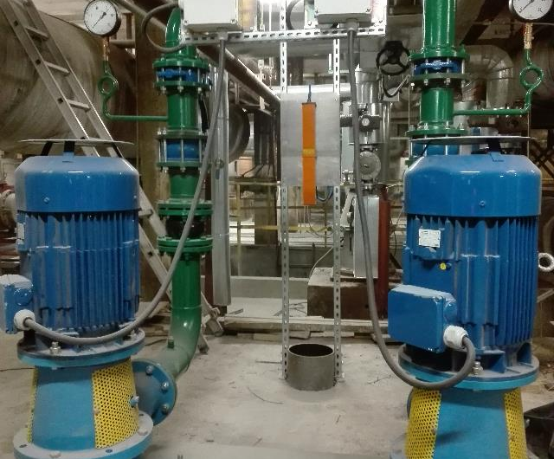
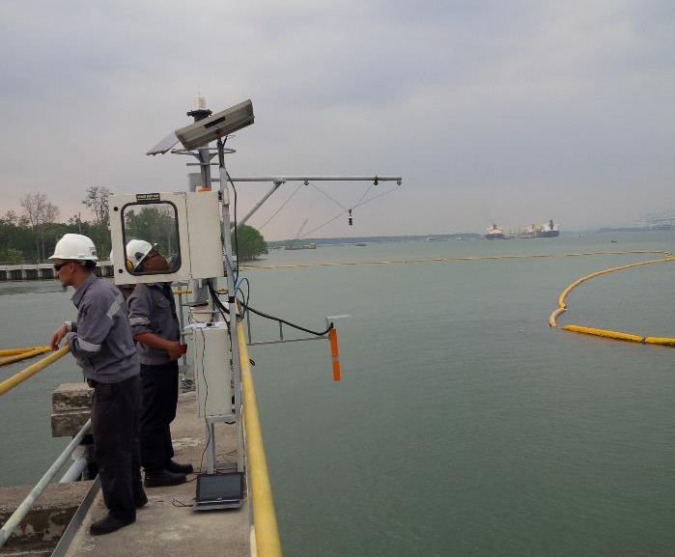
PRESENT APPLICATIONS
Power Plants: thermal, gas, nuclear, hydro
Power Plant, Poland
Power Plant, Malaysia
9 / 14

Slide 10
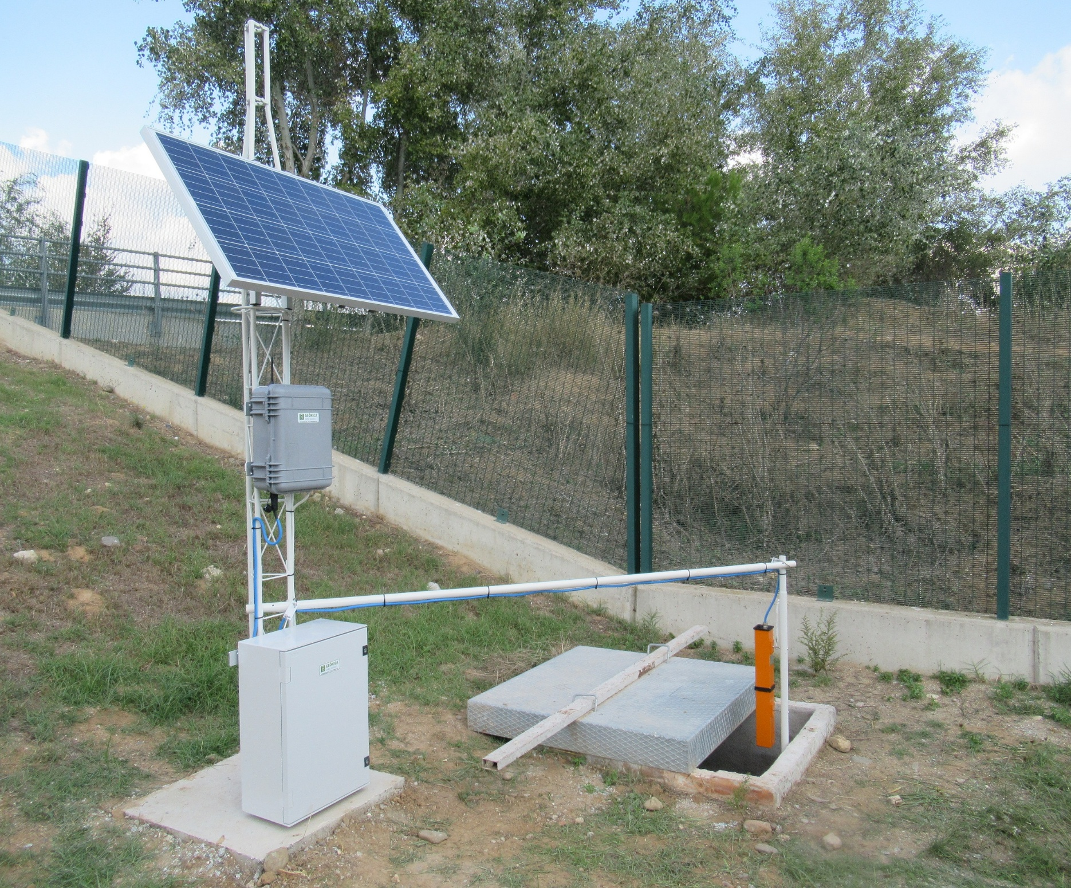
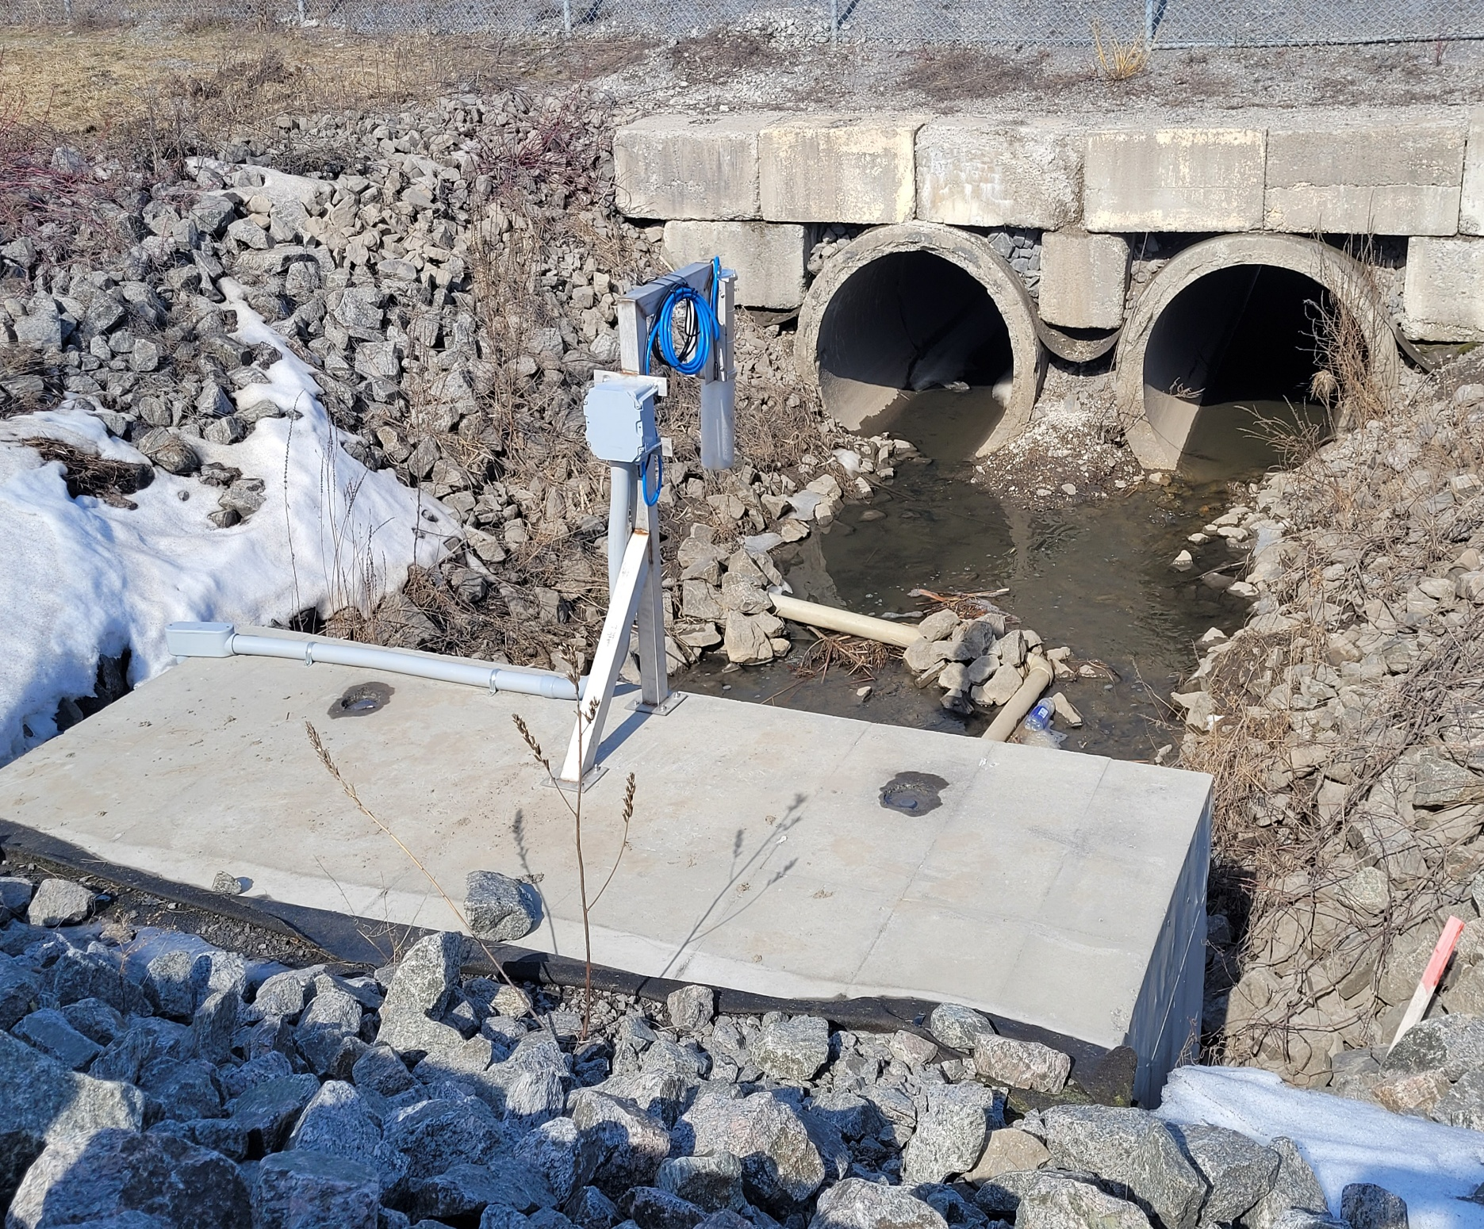
PRESENT APPLICATIONS
Logistics: manufacturing, transport
Beverage plant, Spain
Airport, Canada
10 / 14

Slide 11
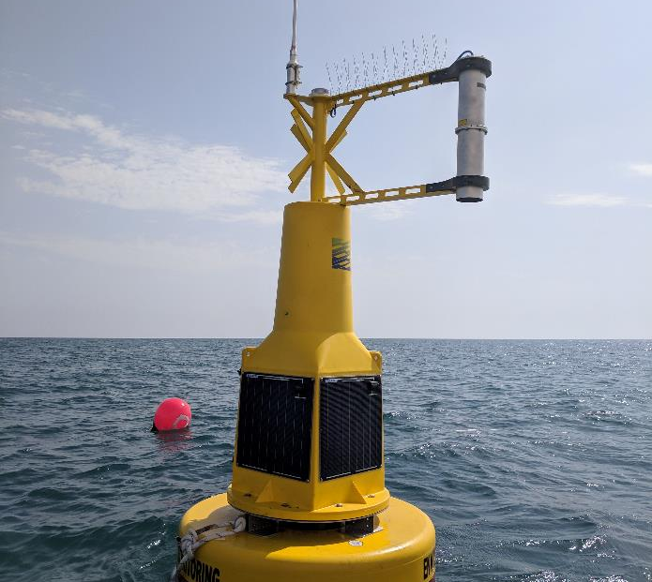
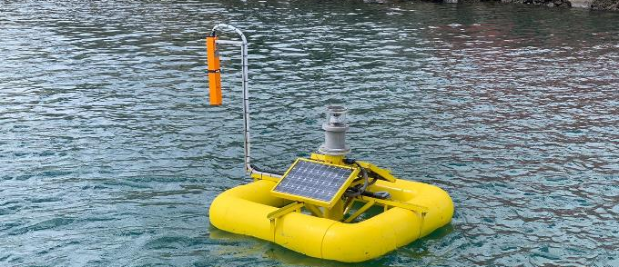
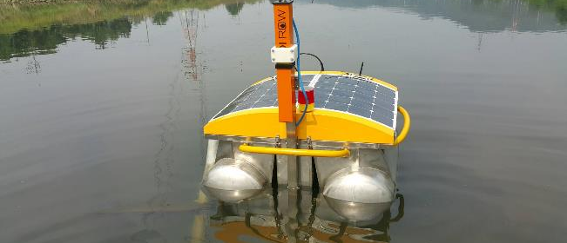
ROW: OFF-GRID INSTALLATIONS
Coastal Monitoring, Canary Islands
Power & Desalination Plant, UAE
Lake Monitoring, South Korea
11 / 14

Slide 12



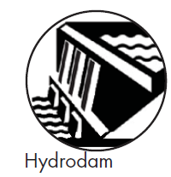

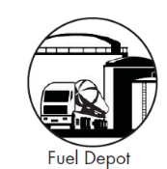

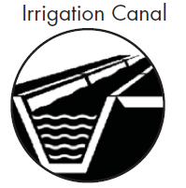


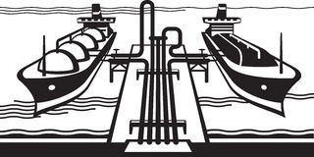
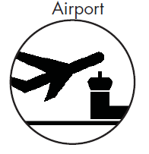
Chemical
Pulp and Paper
Metal
Beverage & Food
Cement
Microchips
12 / 14

Slide 13















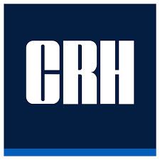












































SOME OF OUR END USERS
13 / 14

Slide 14
THANK YOU!
www.ldi.ee

